Slide 1



Crop Recommendation System: A Machine Learning-Based Approach for Smart Farming.

Slide 2

Learning Objectives
Improve agricultural productivity
Optimize crop selection
Provide data-driven recommendations to farmers
GOAL
GITHUB LINK : https://github.com/piyush794/Crop-Fertilizer-Recommendation-System.git

Slide 3
Tools and Technology used
Programming Language: Python
Libraries & Frameworks: Pandas, NumPy, Scikit-learn,Matplotlib, Seaborn
IDE: Jupyter Notebook
Dataset: Public agricultural datasets (Kaggle, government sources)

Slide 4
Methodology
Data Preprocessing: Handling missing values, feature scaling
Machine Learning Models: Logistic Regression ,Decision Tree, Random Forest, SVM
Model Evaluation: Accuracy, Precision, Recall, Confusion Matrix

Slide 5
Problem Statement:
Unpredictable Climate Changes
Extreme weather events affect crop yields.
Farmers struggle with decision-making due to unpredictable conditions.
Soil Degradation & Nutrient Imbalance
Excessive use of fertilizers reduces soil fertility.
Farmers lack access to proper soil health analysis.
Lack of Data-Driven Decision Making
Crop selection is based on experience rather than scientific methods.
Leads to inefficient farming practices and reduced productivity.
Overuse of Water & Resources
High-water-demand crops strain groundwater levels.
Lack of optimized irrigation methods.
Market Demand & Supply Mismatch
Farmers often grow crops that are already in surplus, reducing profits.
No system to align farming with market trends.
Limited Access to Agricultural Technology
Many farmers do not use modern techniques for improved yield.
Need for an easy-to-use technology-driven solution.

Slide 6
Solutions Provided by Our System
✅ Smart Crop Recommendation
Suggests the best crop based on soil nutrients, climate conditions, and historical data.
✅ Machine Learning-Based Predictions
Uses trained models to analyze soil and weather parameters for accurate recommendations.
✅ Efficient Resource Utilization
Helps farmers select crops that require optimal water and fertilizer usage.
Prevents excessive use of chemical fertilizers to maintain soil health.
✅ Data-Driven Decision Making
Eliminates guesswork and improves agricultural planning.
Helps farmers make informed decisions with scientific analysis.
✅ Higher Profitability & Sustainability
Guides farmers to grow crops with better market demand.
Reduces losses due to overproduction and supply-demand mismatch.
✅ User-Friendly Implementation
Can be deployed as a web or mobile app for easy access.
Helps rural farmers with an accessible and simple interface.

Slide 7
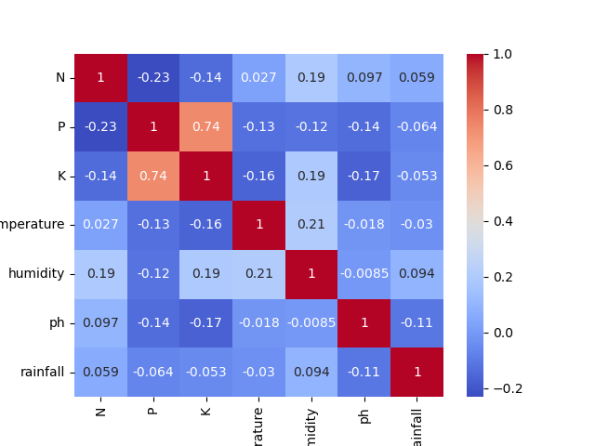
Dataset and Feature Relationships
Dataset Overview
The dataset contains soil and environmental parameters along with the most suitable crop.
Key Features:
Soil Nutrients: Nitrogen (N), Phosphorus (P), Potassium (K)
Climate Conditions: Temperature (°C), Humidity (%), Rainfall (mm)
Soil pH Level: Affects nutrient availability and crop growth
Target Variable: Recommended crop based on given conditions
Feature Relationships & Insights
Soil Nutrients vs. Crop Type
Different crops require varying levels of NPK (Nitrogen, Phosphorus, Potassium).
Example: Legumes need less nitrogen, while cereals require high nitrogen.
Temperature & Humidity Impact
High temperatures favor tropical crops, while low temperatures suit temperate crops.
Humidity affects disease susceptibility and crop water needs.
Rainfall & Soil pH Influence
Rainfall impacts soil moisture, crucial for water-sensitive crops like rice.
pH determines nutrient absorption; acidic soils favor crops like tea, while alkaline soils suit barley.
Correlation Analysis (Heatmap Insights)
Strong correlations between humidity & rainfall (high moisture content).
pH has a moderate impact on crop selection but varies by region.

Slide 8
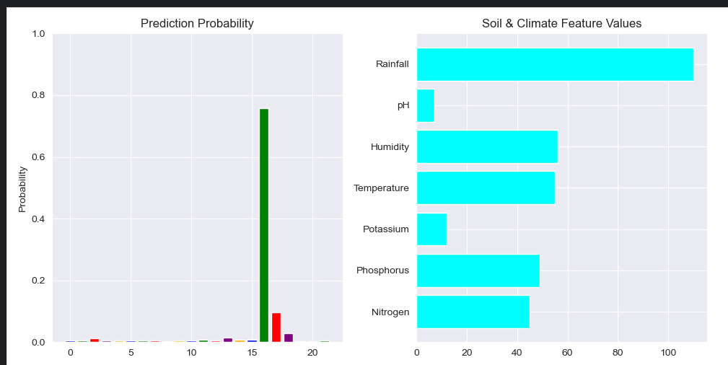
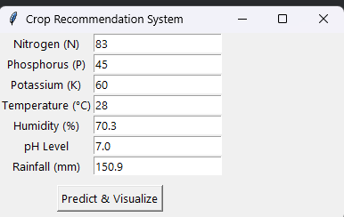
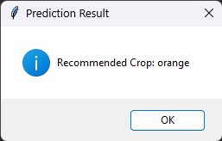
User Interface (UI)
Built with Python Tkinter for a simple and user-friendly experience.
Input Fields: Users enter soil and environmental parameters:
Nitrogen (N), Phosphorus (P), Potassium (K), Temperature (°C), Humidity (%), pH Level, Rainfall (mm).
Predict Button: Click to generate crop recommendations.
Popup Message: Displays the most suitable crop for cultivation.
Graphs & Visualizations
Prediction Probability Chart (Bar Graph)
Displays the probability of different crops.
Helps understand model confidence in predictions.
Soil & Climate Feature Values (Bar Graph)
Shows user-input values for soil and climate parameters.
Helps users compare input values.

Slide 9
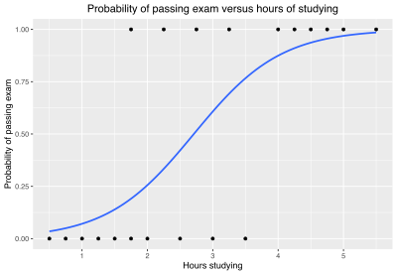
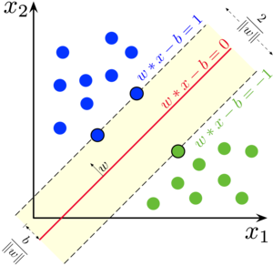
Machine Learning Models Used
1. Logistic Regression
A simple, interpretable model for classification.
Assumes a linear relationship between input features and output.
Works well for binary classification but may struggle with complex patterns.
2. Support Vector Machine (SVM)
A powerful classification model that finds the optimal decision boundary.
Works well for high-dimensional data and can handle non-linearity using kernels.
Effective for smaller datasets but computationally expensive for large-scale problems.

Slide 10
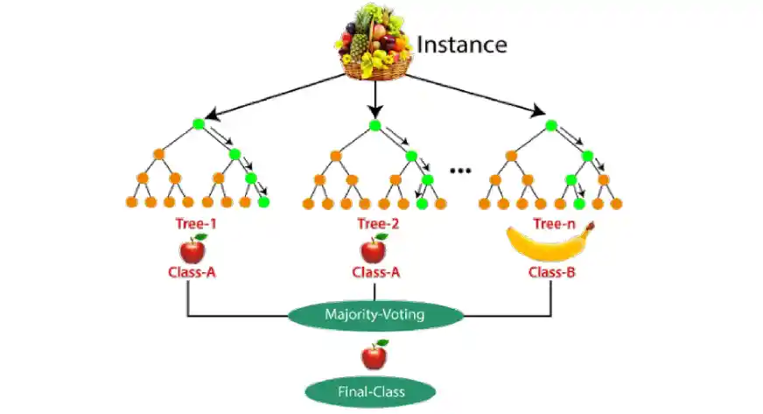
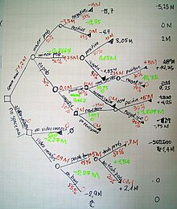
3. Random Forest Classifier
An ensemble learning method combining multiple decision trees.
Reduces overfitting by averaging multiple predictions.
Performs well with non-linear data and feature importance analysis.
4. Decision Tree Classifier
A tree-based model that splits data into decisions using feature values.
Easy to interpret but prone to overfitting without pruning.
Useful for understanding the most influential factors in crop recommendation.
5. XGBoost Classifier (Extreme Gradient Boosting)
A highly optimized gradient boosting algorithm.
Handles missing values, performs feature selection, and prevents overfitting.
Best suited for large and complex datasets, often outperforming other models.

Slide 11
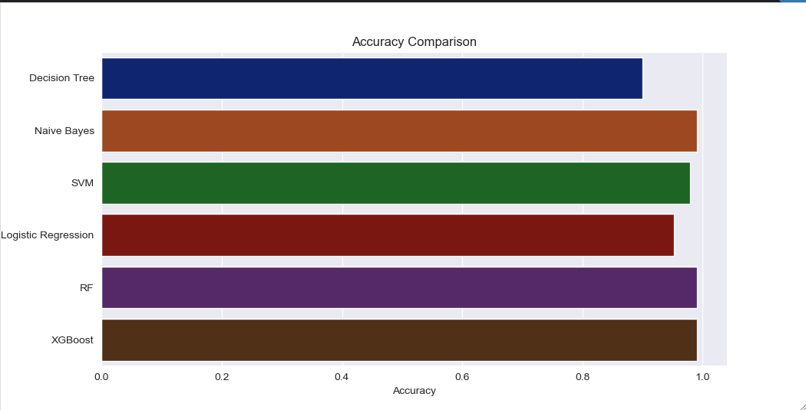
Screenshot of Accuracy of different Models :

Slide 12
Conclusion :
The system provides accurate crop recommendations.
Helps farmers make data-driven decisions.
Future Enhancements:
Expand dataset for higher accuracy.
Mobile app for farmer accessibility.
We can make smart agricultural systems using real time monitoring systems and sensors for irrigation and optimal amount of fertilizer usage.
Integrate real-time weather APIs.
GITHUB LINK OF The Project : https://github.com/piyush794/Crop-Fertilizer-Recommendation-System.git

